Slide 1

DATA DRIVEN ISIGHTS FOR NETFLIX CUSTOMER GROWTH AND ENGAGEMENT
By Debapriya Saha
19-Aug-2023

Slide 2
aGENDA
Understanding Our Data: An overview of the dataset structure and its key components.
Tracking Metrics for Customer Growth: Exploring how we measure customer growth and the attributes driving it.
Engaging Sticky Customers: Unpacking the factors that create "sticky" customers and indicators of their happiness.
Enhancing Data Collection for Product Insights: Discussing additional fields for richer insights and product enhancement.
Idea for Customer Growth: Proposing personalized trial offers to attract and retain customers.
Testing and Learning Plan: Outlining the A/B testing approach and iterative learning process.
Predictive Analytics for Engagement: Applying data modeling to evaluate customer engagement.
Conclusion: Summing up key takeaways.

Slide 3
Understanding Our Data
Our dataset consists of two main tables: the Customer table and the Usage table. Each table holds valuable insights that contribute to our understanding of customer behavior, preferences, and engagement.
Customer Table:
Customer_ID: Unique identifier per customer.
Customer_Name: Name of the customer.
Plan: The Netflix usage plan the customer is on.
Signup_Date: The date a customer started their free trial.
First_Charge_Date: The date the customer converted their free trial to a subscription.
Cancel_Date: The date a customer cancels their subscription.
Channel: The marketing channel the customer came through to start their free trial.
Usage Table:
Customer_ID: Unique identifier per customer.
Movie_Name: Name of the movie being viewed.
Movie_Genre: Genre of the movie being viewed.
Movie_Length: Length of the movie being viewed (hours).
Start_Time: The timestamp a customer starts watching a movie.
End_Time: The timestamp a customer stops watching a movie.

Slide 4
Tracking Metrics for Customer Growth Metrics for Customer Growth
How do we measure customer growth?
Total Customer Count: This metric provides an overview of the total number of customers over time i.e.
18
Conversion Rate from Free Trial to Subscription: This metric indicates the percentage of customers who converted from a free trial to a paid subscription. i.e.
55.6%
Churn Rate: Churn rate measures the percentage of customers who have canceled their subscriptions within a given period. i.e. 28%
Customer Retention Rate: This metric considers both new customer acquisitions and churned customers to give you a net growth rate i.e.
72%
Customer Acquisition by Channel: This metric will help to understand which marketing channels are most effective in acquiring new customers
Customer Acquisition Rate by Day: This metric will help to understand customer acquisition rate day by day
Notes:
The resulted value as per provided dataset

Slide 5
Tracking Metrics for Customer Growth Attributes for Increased Growth
What attributes are important for increased growth? Based on the analysis important attributes are “Plan”, “Channel”, “Movie Genre”, “Movie Length”
Conversion Rate by Plan: This metric will help to understand the conversion rate of free trial customers to paid subscribers for different usage plans. This will highlight which plans have higher conversion rates.
Churn Rate by Plan: This metric will help to understand that which plans have a higher rate of customer cancellations
Customer Engagement by Genre: Analyze customer engagement by tracking the average movie length watched and the count of movies viewed per genre.
Usage Patterns over Time: This metric will help to understand how customer usage patterns change over time by analyzing the number of movies watched and average movie length per month
Notes:
The resulted value as per provided dataset

Slide 6
Engaging Sticky Customers
What type of usage creates sticky customers (customers who retain at high rates)?
How can we tell if our customers are happy?
Plan Preferences of Retained Customers: This metric will help to understand the plan references of retained customers
Movie Genres of Retained Customers: This metric will help to understand the movie genres usage of retained customers
Usage Frequency: This metric will help to understand how frequently customers are using the service. Happy customers tend to use a service more frequently.
Channel Preferences of Retained Customers: This metric will help to understand the Channel references of retained customers
Notes:
The resulted value as per provided dataset

Slide 7


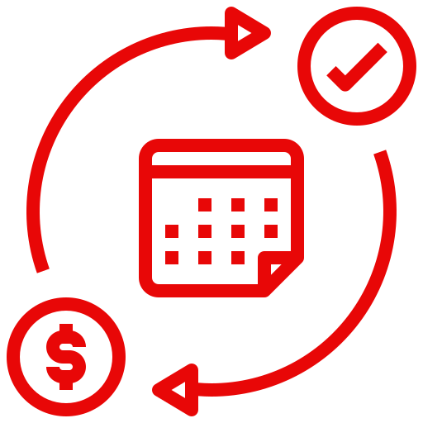
Enhancing Data Collection for Product Insights
What additional fields would we like to instrument in the product and add to the data?
User Ratings and Reviews:
Enabling users to rate and review movies they watch
Gaining direct feedback on content quality and preferences
Viewing Device Type:
Capturing the device used to access our platform (smartphone, tablet, smart TV, laptop etc.)
Understanding user behavior across different devices.
Subscription Charge History:
Recording changes in subscription plans and pricing for each user.
Identifying patterns in user behavior related to plan changes.

Slide 8
Idea for Customer Growth & Testing and Learning Plan
Analyzing Data Points:
1. Channel Conversion Rates:
Understand which marketing channels have the highest conversion rates.
Tailor trial offers to align with the most successful channels.
2. Cohort Analysis: Retention & Churn Rates:
Identify groups with the highest retention rates after conversion.
Customize trial duration and benefits for these groups.
Testing and Learning Plan:
Testing Approach:
A/B Testing: Trial Offers with Personalization vs Standard Offers
Key Metrics:
Conversion Rate: How many people decide to try out the personalized trial?
Retention Rate: How many people decide to try out the personalized trial?
Learning Plan:
Analyze Conversion and Retention Differences: We'll compare how the two groups performed.
Iterate Based on Results: We'll compare how the two groups performed.
Idea & Belief:
Implementing Personalized Trial Offers based on customer preferences, such as genre preferences and usage patterns. The belief is that tailoring trial offers will increase conversions and retention, ultimately leading to sustainable growth.
We can also show visual comparison of conversion rates before and after the implementation of personalized trial offers

Slide 9
Predictive Analytics for Engagement
As we focus on increasing customer engagement, We can explore predictive analytics can be a powerful tool to achieve this goal.
Applying Data Modelling for Engagement:
1. Predicting User Preferences:
Recommending movies based on genre and user watch history.
Personalizing content suggestions to cater to individual tastes.
Utilizing Predictive Models to Curate Content:
2. Data Insights and Pattern Recognition:
Analyzing user behavior and historical data to identify patterns.
Understanding which genres and types of movies resonate with each user.
3. Delivering Content that Resonates with Individual Users:
Generating recommendations using predictive algorithms.
Presenting users with content that matches their preferences.

Slide 10
Conclusion
Summary of Key Points:
We Explored: We entered into the world of data-driven strategies to help Netflix customer grow and engagement
What We've Learned: We've seen how data can guide us in understanding customer preferences, making customer experience even better.
Strategy in a Nutshell: Our plan involves tailored offers, better recommendations, and improving how we understand what customer love.
Why It Matters:
Customer Experience Matters: These strategies aren't just about numbers – they're about enhancing customer time on Netflix and making them enjoy it more.
Customer Input Counts: Customer feedback and choices shape how we develop and make improvements.
Our Promise: We're committed to giving the customer great content in a way that suits them best.

Slide 11
THANK You…

